Slide 1

Instagram User Analytics trainity PROJECT #2
Submitted by:
Anurag Changmai
Data Analytics Trainee
16/06/2023

Slide 2
Project Description
User analytics form a core part of every digital product, be it a mobile application, software, or website. It enables a wider understanding of user behavior based on interaction with the product, which provides valuable insights, and consequently, helps in effective decision-making.
In this project, a dataset of users on the Instagram platform is utilized. This dataset is sorted to produce specific output to obtain user interactions (posts, likes, comments, etc.) and derive meaningful insights.
These insights are then analyzed from a marketing and investment point-of-view. In doing so, parameters like user loyalty, user engagement, hashtag usage, and bot identification are found. These insights will help in user targeting, deciding what ad campaigns to run and when, and eliminating bots for a leaner, improved marketing and investment strategy.

Slide 3
Approach
This project starts by first obtaining a sample dataset of users and their interactions on the Instagram platform.
This data is then cleaned and stored in a database called ig_clone, using multiple tables such as comments, follows, likes, photo_tags, photos, tags, and users.
Once this is done, SQL queries are executed on these tables to obtain specific data as per requirements.

Slide 4
Tech-stack used
In the execution of this project, the following software was used:
1. Oracle MySQL Workbench 8.0 v8.0.33
→ It was used to run SQL queries for creating the database, performing operations on the tables within the database, and obtaining desired outputs.

Slide 5
Insights
In the following slides, insights on the following points are obtained:
From a Marketing POV:
1. Identifying the 5 oldest users on the Instagram platform based on the available dataset to reward them for their loyalty
2. Identifying users who have not posted a single photo on the Instagram platform to send promotional emails reminding them to start posting
3. Identifying the user who gets the most likes on a single photo to be declared the winner of a new contest
4. Identifying the 5 most used hashtags on the Instagram platform so as to use them for expanded reach
5. Identifying the day(s) of the week when most users register on the Instagram platform in order to schedule an ad campaign accordingly

Slide 6
Insights (cont.)
From an Investor’s POV:
1. Identifying average posts per user on the Instagram platform to understand if users are active
2. Identifying fake accounts/bots to clean up and streamline target audience

Slide 7
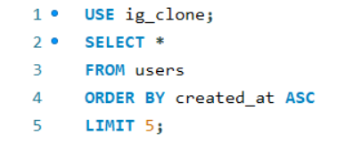
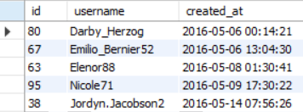
1. Identifying the 5 oldest users
SQL Query
REsults
The results show that users ‘Darby_Herzog’, ‘Emilio_Bernier52’, ‘Elenor88’, ‘Nicole71’, and ‘Jordyn.Jacobson2’ are the oldest users in that order on the platform

Slide 8
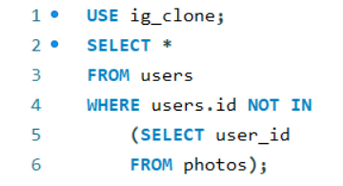
2. Identifying users who have not posted a single photo
SQL QUERY

Slide 9
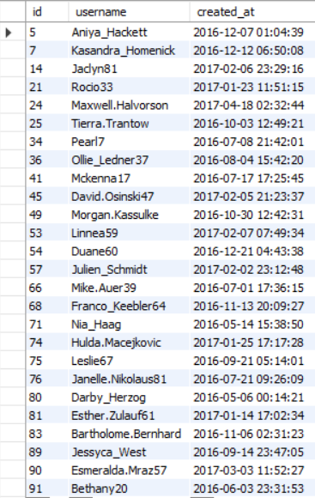
2. Identifying users who have not posted a single photo (Cont.)
RESULTS
The results show the user IDs, usernames, and profile creation dates of 26 users who have not posted a single photo on the platform

Slide 10
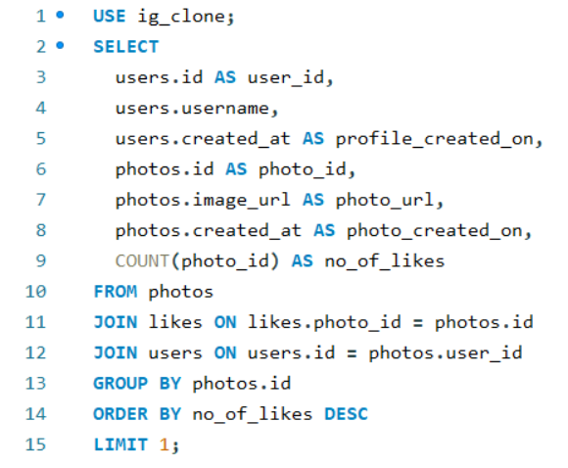
3. Identifying the user with the most likes on a single photo
SQL QUERY

Slide 11
3. Identifying the user with the most likes on a single photo (Cont.)
RESULTS
The results show that user ‘Zack_Kemmer93’ with user ID 52 posted a photo with ID 145 on 13/06/2023 at 9:21 pm that has received 48 likes, the highest on the platform

Slide 12
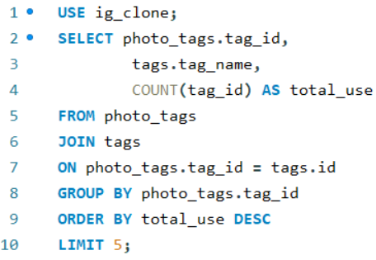
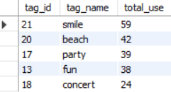
4. Identifying the 5 most used hashtags
SQL query
results
The results show that ‘smile’, ‘beach’, ‘party’, ‘fun’, and ‘concert’ are the 5 most used hashtags in that order on the platform

Slide 13
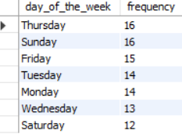
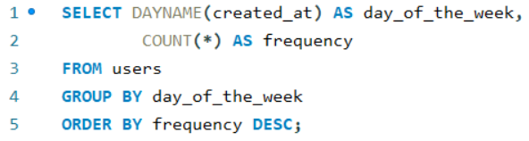
5. Identifying the busiest days of the week in terms of user registration
Sql query
results
The results show that most users register on the platform on Thursdays and Sundays

Slide 14
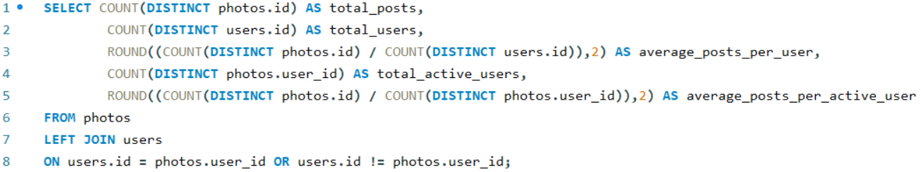
6. Identifying average posts per user
SQL QUERY

Slide 15
6. Identifying average posts per user (Cont.)
RESULTS
The results show that there are a total of 257 posts on the platform. With 100 total users, this gives an average of 2.57 posts per user.
However, these 100 users also contain inactive users (i.e. users who have not posted a single photo) and fake accounts/bots.
Hence, considering the total active users (i.e. users who have posted at least one photo), which is 74, the average number of posts per user is 3.47.

Slide 16
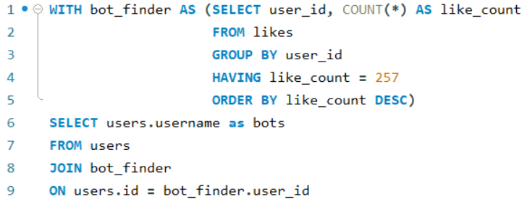
7. Identifying fake accounts/bots
SQL QUERY

Slide 17
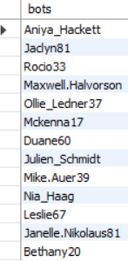
7. Identifying fake accounts/bots (Cont.)
RESULTS
The results show that 13 users have liked every photo on the platform (257 photos).
Considering that any normal user would not be able to do so, these 13 users have been marked as fake accounts/bots.

Slide 18
Result
By identifying active users and cleaning up fake accounts/bots, the management team can now focus on targeting the right users. Next, they can run campaigns on specific days coupled with the usage of specific hashtags to ensure wider reach.
Moreover, by finding and rewarding loyal users as well as users who secure a high number of likes on their posts, the campaign could be further publicized. It will also ensure continued patronage by existing users while also securing more users, who are attracted by the fact that the platform looks after its regular users. This could, in turn, lead to more posts by more users, thereby increasing the average posts-per-user values.
This project has been very helpful in understanding basic and advanced SQL concepts, as well as the workings of relational databases. Moreover, it provides a peek into how product teams work at organizations, how they handle copious amounts of data, and the valuable insights they produce.

